Slide 1
Time Series

Slide 2

Introduction
A time series is a collection of records ordered by time.
$y_{t}$ $for t=1,2,3,…,T$
where $T$ is the number of periods.

Slide 3
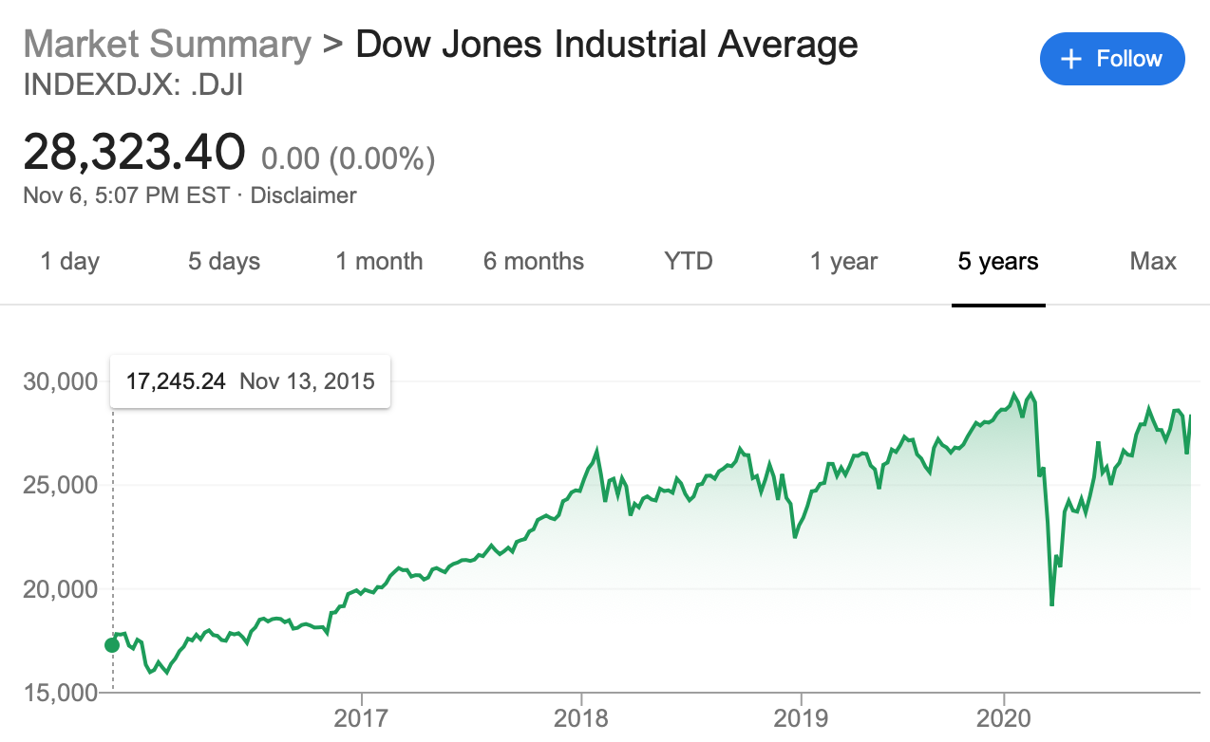

Introduction
The time period
is days.
Approximately,
$T=365∗5$days
in this
time series.

Slide 4
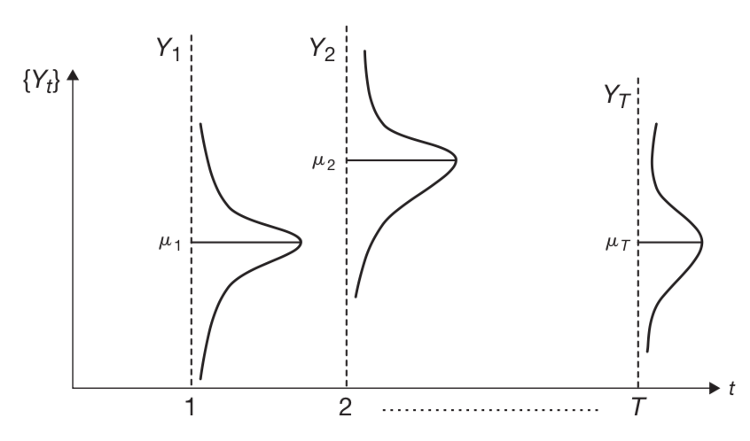
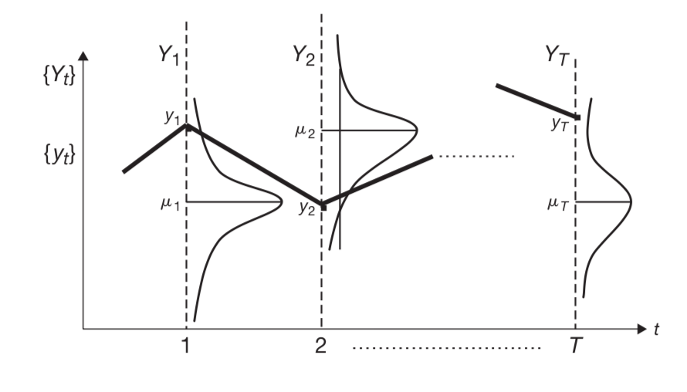

Introduction
Let $Y$ be a random variable, with outcomes $y_{1}$, $y_{2}$, $y_{3}$…
Then we can define a stochastic process $\left\{Y_{t}\right\}=\left\{Y_{1},Y_{2},Y_{3},…Y_{T}\right\}$
as a collection of random variables indexed by time.

Slide 5

Introduction
$y_{t}= \left\{y_{1}\text{, }y_{2}\text{, }y_{3}, … \right\}$ is a time series sample corresponding to the stochastic process.
A time series is a sample realization of a stochastic process.

Slide 6
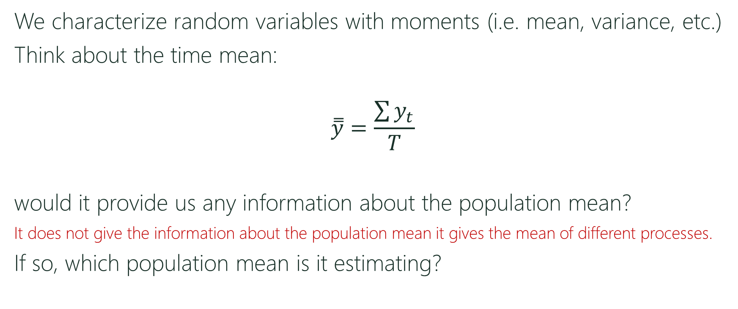
Introduction
We characterize random variables with moments (i.e. mean, variance, etc.)
Think about the time mean:
$$\overset{̿}{y}=\frac{\sum{y_{t}}}{T}$$
would it provide us any information about the population mean?
It does not give the information about the population mean it gives the mean of different processes.
If so, which population mean is it estimating?

Slide 7
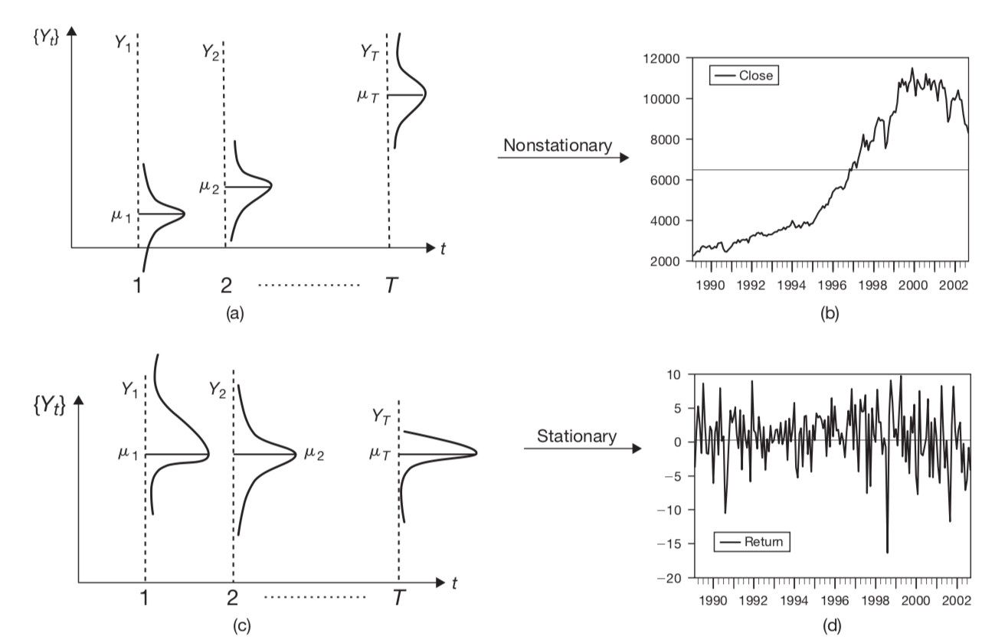
Stationarity
The solid black line
is the time mean of the
series.
Relationship between time series
Notes:
The mean in the first graph is useless. It is visited once and then never again. In the second series, the value revert or are centered by this mean.

Slide 8
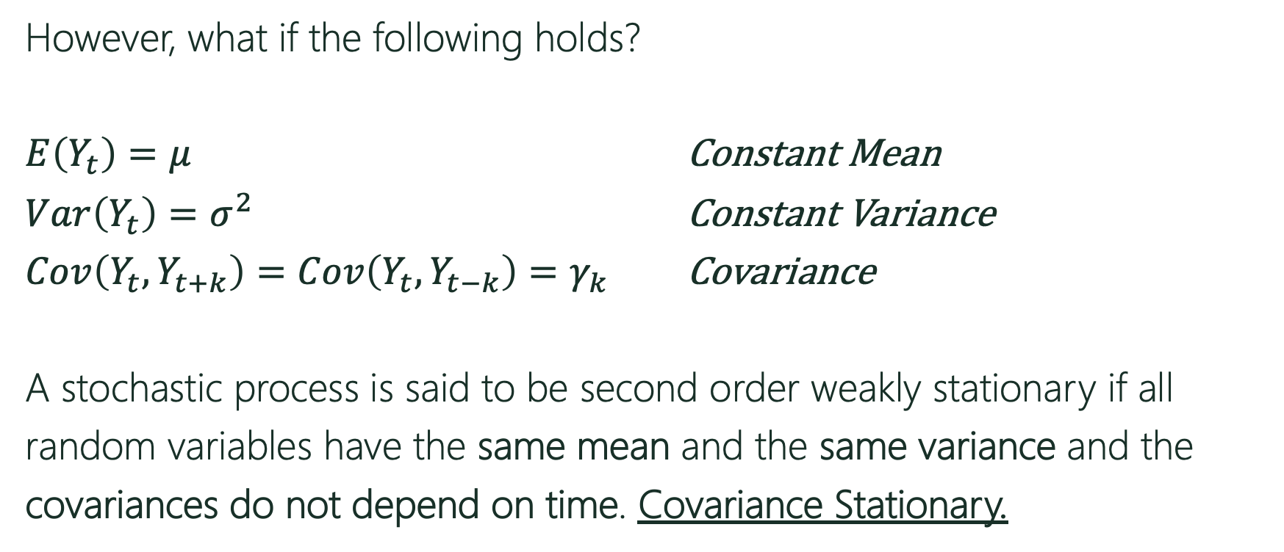
Stationarity
However, what if the following holds?
$E\left(Y_{t}\right)=μ$ Constant Mean
$Var\left(Y_{t}\right)=σ^{2}$ Constant Variance
$Cov\left(Y_{t},Y_{t+k}\right)=Cov\left(Y_{t},Y_{t−k}\right)=γ_{k}$ Covariance
A stochastic process is said to be second order weakly stationary if all
random variables have the same mean and the same variance and the
covariances do not depend on time. Covariance Stationary.
Notes:
We could be very restrictive-> A stochastic process is said to be first order strongly stationary if all
random variables have the same probability density function.
We could be less restrictive->A stochastic process is said to be first order weakly stationary if all
random variables have the same mean.
A stationary time series can be treated as any other random variable, by investigating its mean and variance.

Slide 9
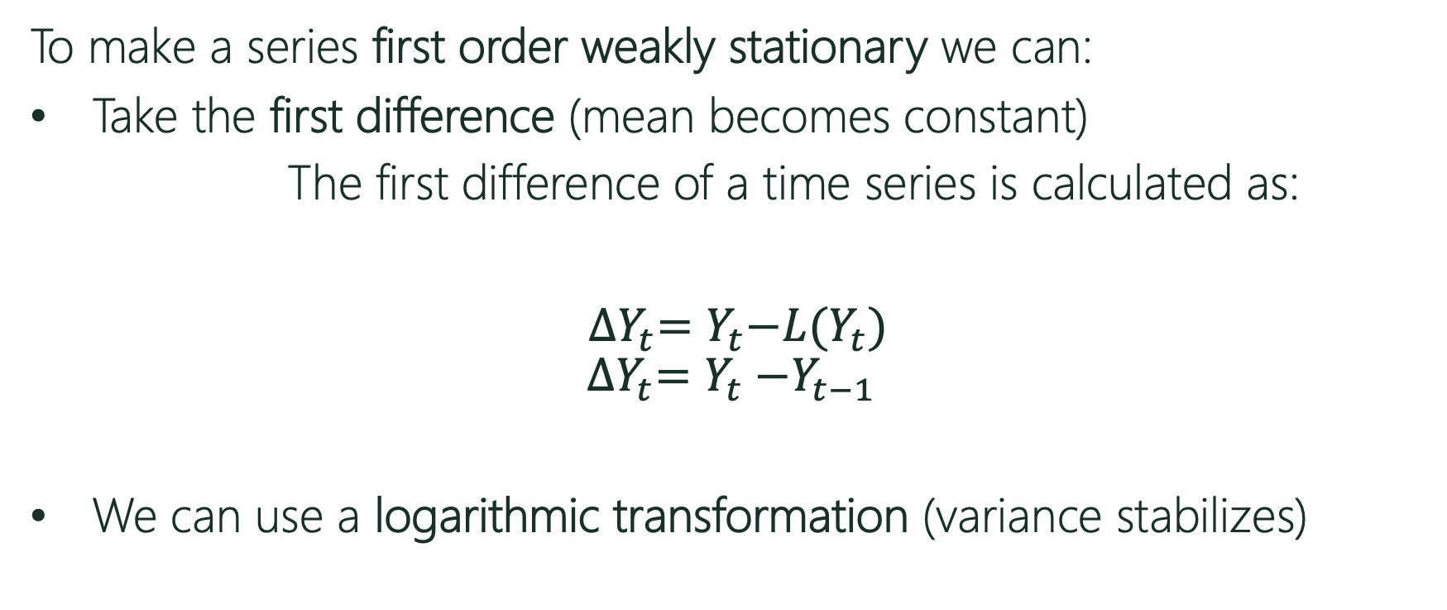
Transformations
To make a series first order weakly stationary we can:
Take the first difference (mean becomes constant)
The first difference of a time series is calculated as:
${∆Y}_{t}=Y_{t}{−L(Y}_{t})$
$${∆Y}_{t}=Y_{t}{−Y}_{t−1}$$
We can use a logarithmic transformation (variance stabilizes)
Lag operator
Notes:
Box Cox Transformation
wt={log(yt)if λ=0;
(yλt−1)/λotherwise.
The BoxCox.lambda() function will choose a value of lambda for you.

Slide 10
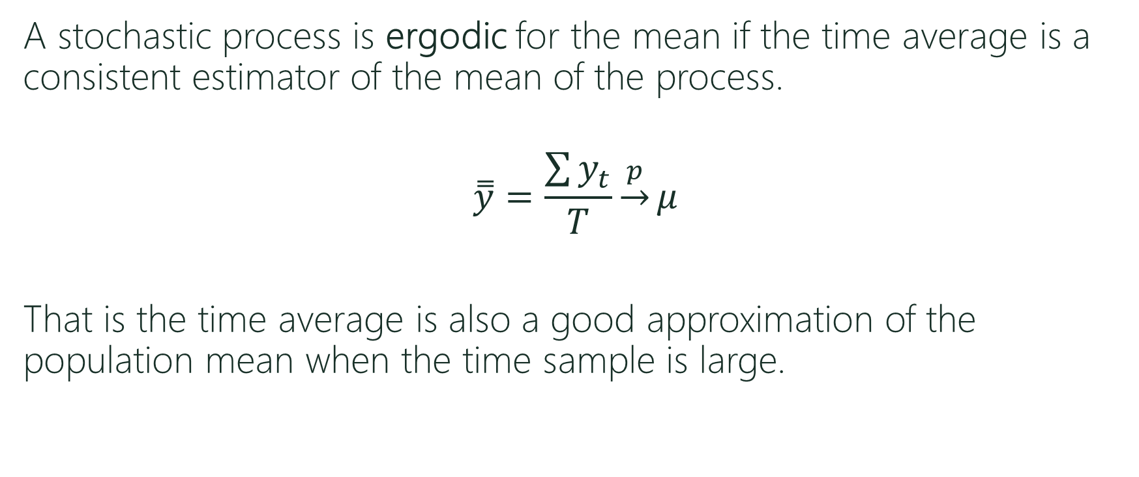
Ergodicity
A stochastic process is ergodic for the mean if the time average is a consistent estimator of the mean of the process.
$$\overset{̿}{y}=\frac{\sum{y_{t}}}{T}\underset{→}{p}μ$$
That is the time average is also a good approximation of the population mean when the time sample is large.

Slide 11
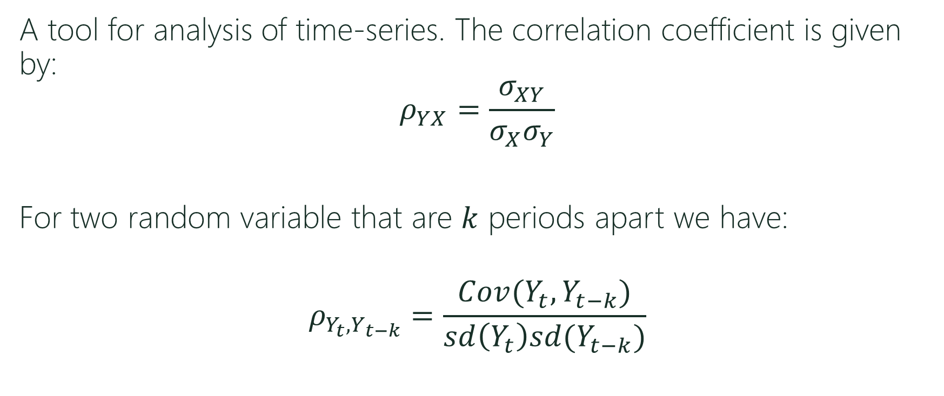
Autocorrelation function (ACF)
A tool for analysis of time-series. The correlation coefficient is given by:
$$ρ_{YX}=\frac{σ_{XY}}{σ_{X}σ_{Y}}$$
For two random variable that are $k$ periods apart we have:
$$ρ_{Y_{t},Y_{t−k}}=\frac{Cov(Y_{t},Y_{t−k})}{sd\left(Y_{t}\right)sd(Y_{t−k})}$$
Notes:
Cov – relationship between 2 variables.
Corr – how strong the relationship is.

Slide 12
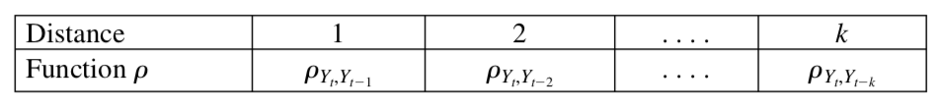

Autocorrelation function (ACF)
The autocorrelation function maps distances between random variables to correlations:
$$ρ:k→ρ_{Y_{t},Y_{t−k}}$$
where $k$ is some time distance.

Slide 13
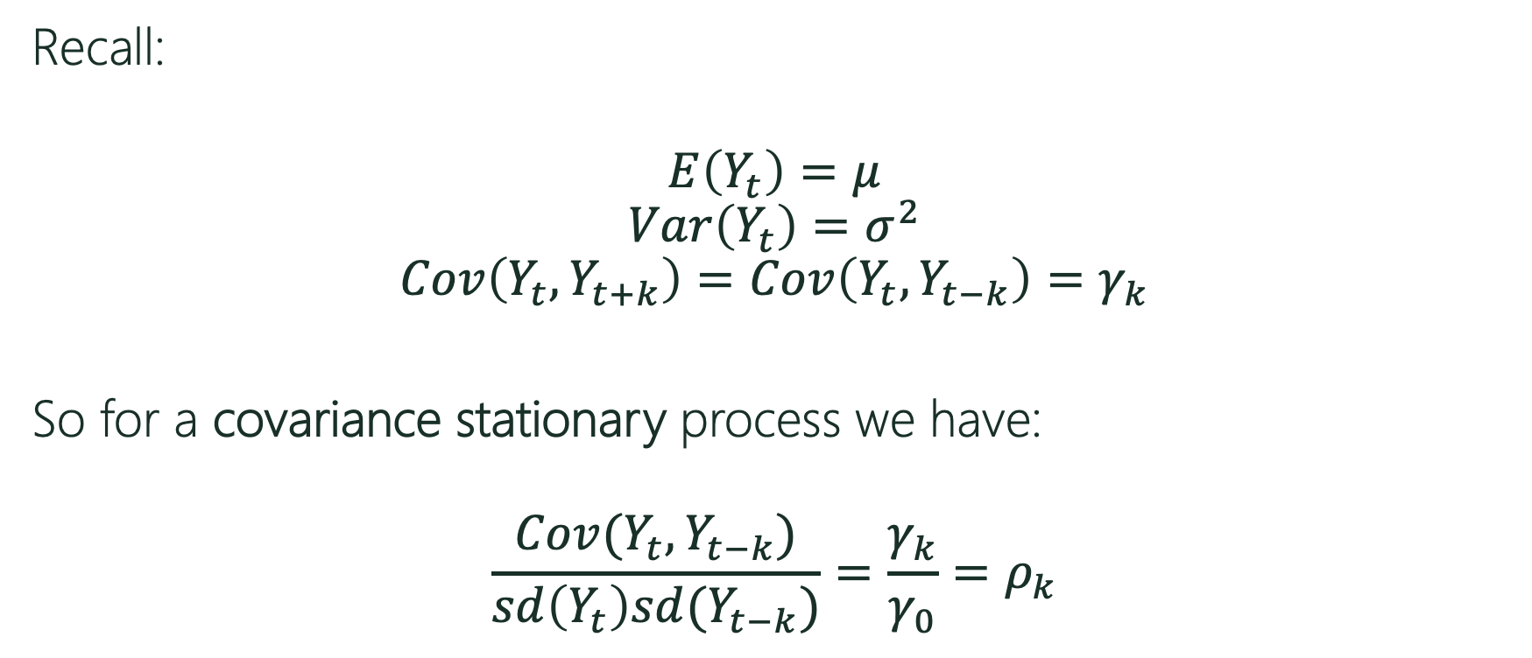
Autocorrelation function (ACF)
Recall:
$$E\left(Y_{t}\right)=μ$$
$$Var\left(Y_{t}\right)=σ^{2}$$
$$Cov\left(Y_{t},Y_{t+k}\right)=Cov\left(Y_{t},Y_{t−k}\right)=γ_{k}$$
So for a covariance stationary process we have:
$$\frac{Cov(Y_{t},Y_{t−k})}{sd\left(Y_{t}\right)sd(Y_{t−k})}=\frac{γ_{k}}{γ_{0}}=ρ_{k}$$
Notes:
Note that sd(Yt)=sigma and sd(Yt-k) is also equal to sigma. The denominator is equal to sigma square (or covariance between yt and yt).

Slide 14
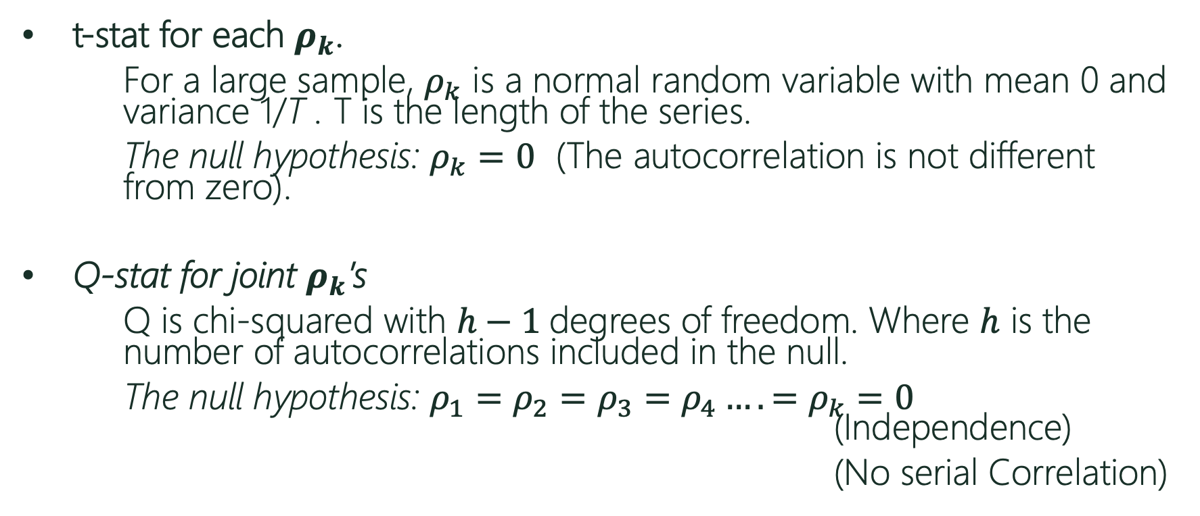
Significance (t-stat and Ljung-Box)
t-stat for each $ρ_{k}$.
For a large sample, $ρ_{k}$ is a normal random variable with mean 0 and variance 1/T . T is the length of the series.
The null hypothesis: $ρ_{k}=0$ (The autocorrelation is not different from zero).
Q-stat for joint $ρ_{k}$’s
Q is chi-squared with $h−1$degrees of freedom. Where $h$ is the number of autocorrelations included in the null.
The null hypothesis: ${ρ_{1}=ρ_{2}=ρ_{3}=ρ_{4}….=ρ}_{k}=0$ (Independence)
(No serial Correlation)

Slide 15
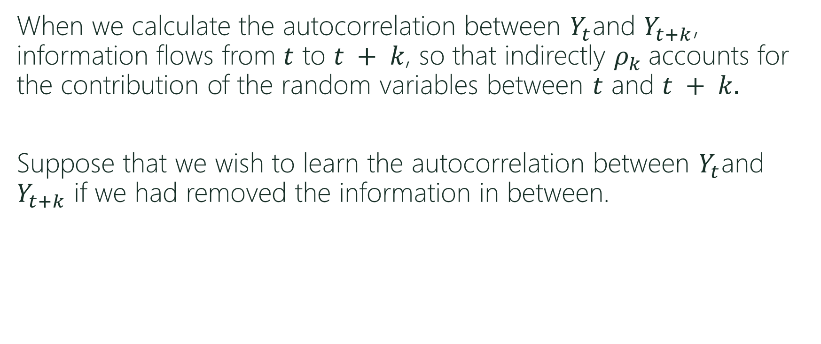
Partial Autocorrelation function (PACF)
When we calculate the autocorrelation between $Y_{t}$and $Y_{t+k}$, information flows from $t$ to $t + k$, so that indirectly $ρ_{k}$accounts for the contribution of the random variables between $t$ and $t + k.$
Suppose that we wish to learn the autocorrelation between $Y_{t}$and $Y_{t+k}$ if we had removed the information in between.

Slide 16
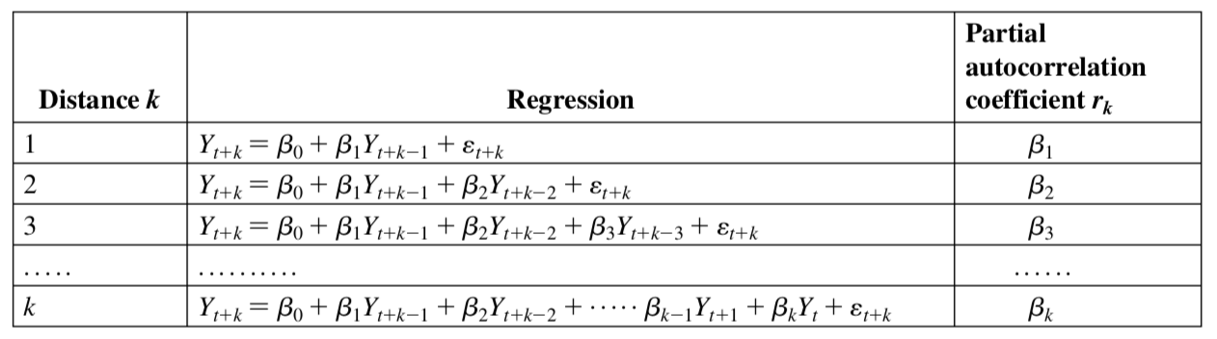

Partial Autocorrelation function (ACF)
To compute the partial autocorrelation function you can run several regressions as follows:
$$r:k→r_{k }$$

Slide 17
Test You Understanding
In R:
Load the DJdata set.
Plot the data. Is the data stationary?
Use the diff() function to difference your data. Now plot the first difference. Does the mean look constant? Does the variance look constant?
Use a logarithmic transformation. Did the variance stabilize?

Slide 18
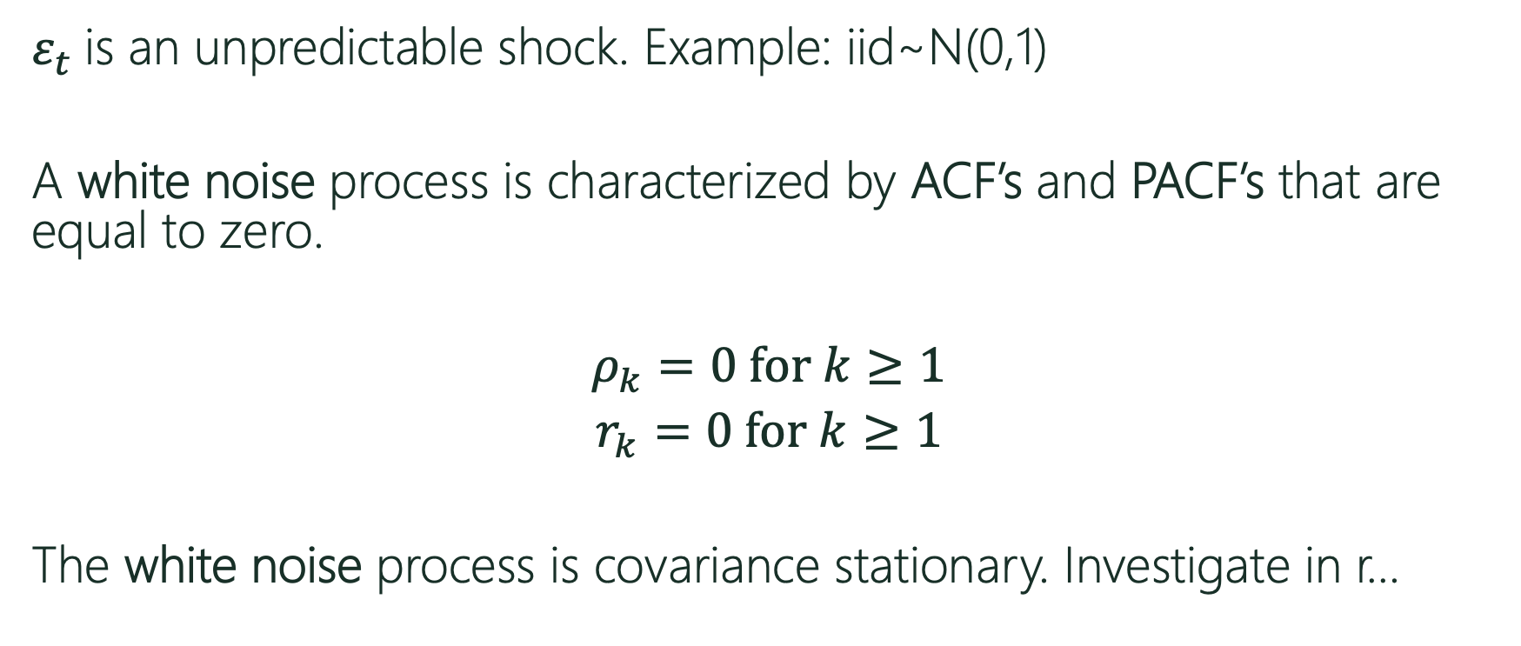
White Noise Process
$ε_{t}$ is an unpredictable shock. Example: iid~N(0,1)
A white noise process is characterized by ACF’s and PACF’s that are equal to zero.
$ρ_{k}=0$ for $k≥1$
$r_{k}=0$ for $k≥1$
The white noise process is covariance stationary. Investigate in r…
Notes:
Observe in R

Slide 19
Test Your Understanding
In R:
Download and Load the “forecast” package.
Calculate the ACF for the stationary DJ data. Are there any statistically significant lags?
Calculate the PACF for the stationary DJ data. Are there any statistically significant lags? Can you calculate the same numbers using regression? (hint: use the “dynlm” package)
Repeat for the working hours data sets, Germany and USA.

